Slide 1
CSI1003 Formal Languages and Automata Theory
MODULE - 4
Dr. WI. Sureshkumar
Associate Professor
School of Computer Science and Engineering (SCOPE)
VIT Vellore
wi.sureshkumar@vit.ac.in
SJT413A34

Slide 2
Module -4
Context Free Grammars:
Context-Free Grammar (CFG)
Derivations - Parse Trees
Ambiguity in CFG
CYK algorithm
Simplification of CFG
Elimination of Useless symbols, Unit productions, Null productions
Normal forms for CFG: CNF and GNF
Pumping Lemma for CFL
Closure Properties of CFL
Context-sensitive grammars: Definition and Examples

Slide 3
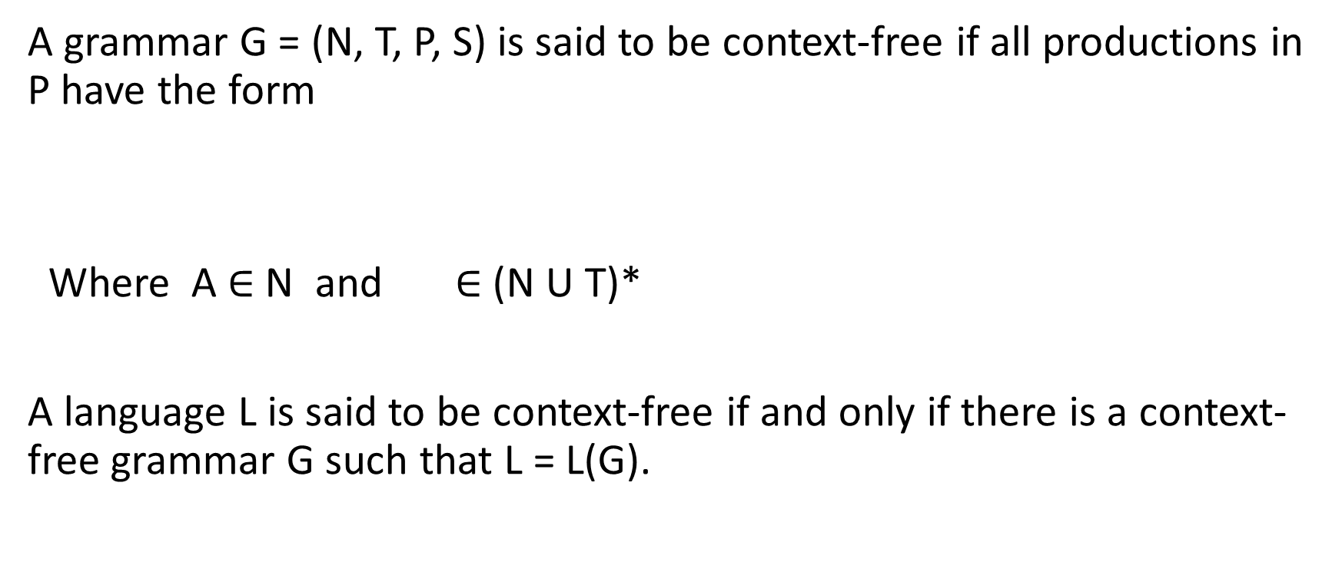
Context Free Grammar (CFG)
A grammar G = (N, T, P, S) is said to be context-free if all productions in P have the form
Where A $∈$ N and $∈$ (N U T)*
A language L is said to be context-free if and only if there is a context-free grammar G such that L = L(G).

Slide 4
Examples
1)
G = ({S}, {a, b}, P, S), where
P: S → aSb
S → ab

Slide 5
Examples
2)
G = ({S}, {a, b}, P, S), where
P: S → aSa
S → bSb
S → ε

Slide 6
Examples
3) The grammar G with productions
S → abB
A → aaBb
B → bbAa
A → ε

Slide 7
Examples
4) The language is context-free.
G = ({S, S₁ , A, B }, {a, b}, P, S), where
P: S → AS₁ / S₁B ,
S₁ → aS₁b / ε
A → aA / a
B → bB / b

Slide 8
Derivations - Parse Trees
G= ({E}, {+, *, a, b, c }, P, E), where
P: E → E + E
E → E * E
E → a / b / c
Leftmost derivation (Lmd): w = a + b * c
E E + E a + E a + E * E a + b * E a + b * c
Rightmost derivation (Rmd)
E E + E E + E * E E + E * c E + b * c a + b * c
Derivation:
E E + E E + E * E E + b * E a + b * E a + b * c

Slide 9
Derivations
w = a + b * c
Leftmost derivation (Lmd): 1
E E + E a + E a + E * E a + b * E a + b * c
Leftmost derivation (Lmd): 2
E E * E E + E * E a + E * E a + b * E a + b * c

Slide 10
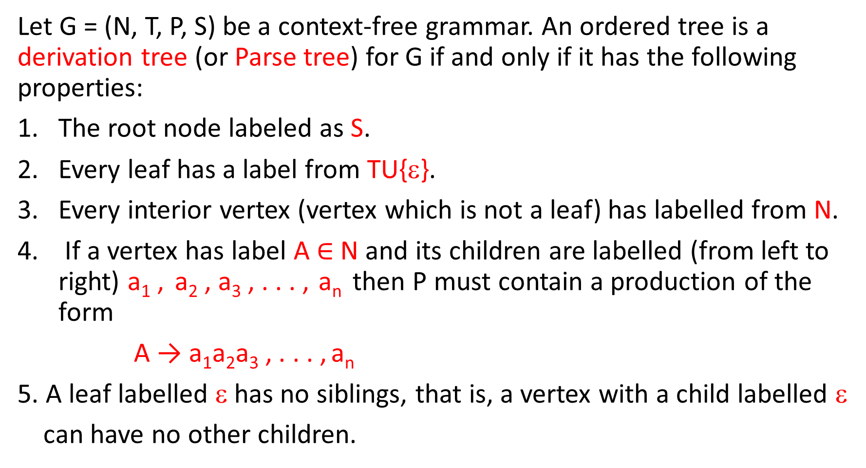
Parse Trees
Let G = (N, T, P, S) be a context-free grammar. An ordered tree is a derivation tree (or Parse tree) for G if and only if it has the following properties:
The root node labeled as S.
Every leaf has a label from TU{ε}.
Every interior vertex (vertex which is not a leaf) has labelled from N.
If a vertex has label A $∈$ N and its children are labelled (from left to right) a₁ , a₂ , a₃ , . . . , a_{n} then P must contain a production of the form
A → a₁a₂a₃ , . . . , a_{n}
5. A leaf labelled ε has no siblings, that is, a vertex with a child labelled ε
can have no other children.

Slide 11
a = 2
b = 3 a + b * c = 14 a + b * c = 20
c = 4 yield of the tree a + b * c
E
E
E
+
E
E
E
*
a
E
*
E
E
+
E
c
b
c
a
b

Slide 12
A tree that has properties 3, 4 and 5, but in which 1 does not necessarily hold and in which property 2 is replaced by
2a) Every leaf has label from NUTU{ε}.
is said to be a Partial derivation tree.
yield of the tree is a + E
E
E
+
E
a

Slide 13
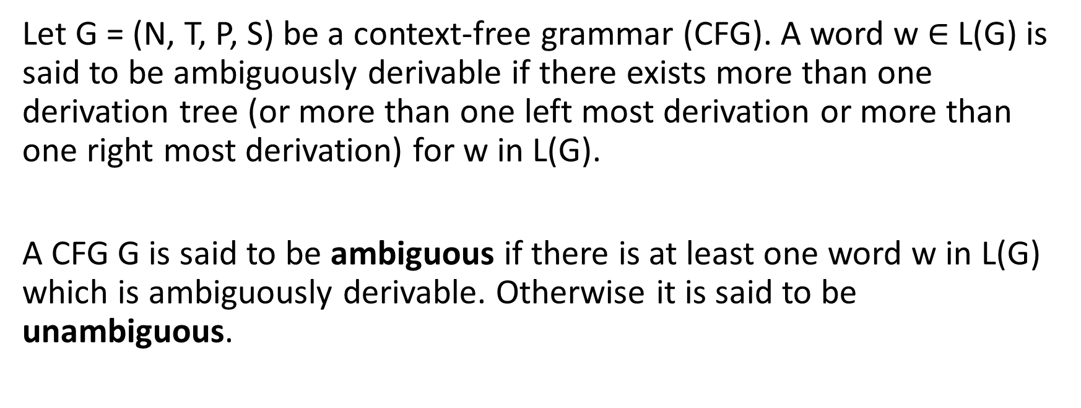
Ambiguity in CFG
Let G = (N, T, P, S) be a context-free grammar (CFG). A word w $∈$ L(G) is said to be ambiguously derivable if there exists more than one derivation tree (or more than one left most derivation or more than one right most derivation) for w in L(G).
A CFG G is said to be ambiguous if there is at least one word w in L(G) which is ambiguously derivable. Otherwise it is said to be unambiguous.

Slide 14
Examples
1) Consider grammar G with productions
S → SaSbS (rule 1)
S → SbSaS (rule 2)
S → ε (rule 3)
G is ambiguous, since w = aabbab has two derivation trees.
S SaSbS εaSbS aSaSbSbS aεaSbSbS aaεbSbS
aabεbS aabbSaSbS aabbεaSbS aabbaεbS
aabbabε =aabbab

Slide 15
S SaSbS εaSbS aSaSbSbS aεaSbSbS aaεbSbS
aabεbS aabbSaSbS aabbεaSbS aabbaεbS
aabbabε =aabbab
1 3 1 3 3 3 1 3 3 3
S SaSbS εaSbS aSaSbSbS aεaSbSbS aaεbSbS
aabSbSaSbS aabεbSaSbS aabbεaSbS aabbaεbS
aabbabε =aabbab
1 3 1 3 3 2 3 3 3 3

Slide 16
S
S
S
a
S
b
S
S
a
S
b
S
ε
ε
ε
S
a
S
b
S
S
a
S
b
S
S
a
S
b
S
ε
ε
ε
ε
ε
ε
ε
ε
S
b
S
a
S
ε
ε
ε

Slide 17
Examples
2) Consider grammar G with productions
S → aSb
S → SS
S → ε
G is ambiguous, since w = aabb has two derivation trees.

Slide 18
S
S
S
S
S
S
ε
ε
a
S
b
a
S
b
a
S
b
a
S
b
ε
ε

Slide 19
Examples
S
3) Consider the grammar G,
G = ({S}, {a, b}, P, S), where
P: S → aSb
S → ab
G is unambiguous grammar.
a
S
b
a
S
b
a
b

Slide 20
A CFL L can be generated by many grammars G₁ , G₂ , G₃ , . . .
L is said to be unambiguous if there is an unambiguous grammar generating L.
If all the grammars generating L are ambiguous, i.e. there is no unambiguous grammar generating L, then L is said to be inherently ambiguous.

Slide 21
Example:
S → aS
S → a
unambiguous grammar.
L(G) = { a^{n} / n ≥ 1 }
S
S
S
S
a
a
S
a
a
S
S
a
S
a
S
a
a
S
a
a

Slide 22
L(G) = { a^{n} / n ≥ 1 }
S → SS
S → a
ambiguous grammar
S
S
S
S
S
S
S
S
a
S
S
S
S
a
a
S
a
a
S
a
a
a
a

Slide 23
Example: (Inherently ambiguous)
L(G) = { a^{n}b^{n} c^{m} / n, m ≥ 1 } U { a^{n}b^{m} c^{m} / n, m ≥ 1 } = L₁ U L₂
G= ({S, S₁, S₂ , A, B, C, D}, {a, b, c}, P, S), where
P: S → S₁ / S₂
S₁ → AB S₂ → CD
A → aAb / ab C → aC / a
B → cB / c D → bDc / bc
L₁∩L₂ = { a^{n}b^{n} c^{n} / n ≥ 1 }

Slide 24
L₁ = { a^{n}b^{n} c^{m} / n, m ≥ 1 }
abc , abc² , abc³ , abc⁴ , abc⁵ , abc⁶ , . . . .
a²b²c , a²b²c² , a²b²c³ , a²b²c⁴ , a²b²c⁵ , a²b²c⁶ , . . . .
a³b³c , a³b³c² , a³b³c³ , a³b³c⁴ , a³b³c⁵ , a³b³c⁶ , . . . .
. . . . . . . . . . . . . . . . . . . . . . . . . . . . . . . . . . . . . . . . . . . . . . . .
L₂ = { a^{n}b^{m} c^{m} / n, m ≥ 1 }
abc , ab²c² , ab³c³ , ab⁴c⁴ , ab⁵c⁵ , ab⁶c⁶ , . . . .
a²bc , a²b²c² , a²b³ c³ , a²b⁴c⁴ , a²b⁵c⁵ , a²b⁶c⁶ , . . . .
a³bc , a³b²c² , a³b³ c³ , a³b⁴c⁴ , a³b⁵c⁵ , a³b⁶c⁶ , . . . .
. . . . . . . . . . . . . . . . . . . . . . . . . . . . . . . . . . . . . . . . . . . . . . . .
L₁∩L₂ = { a^{n}b^{n} c^{n} / n ≥ 1 }

Slide 25
It is undecidable to find whether a CFG is ambiguous or not.
S
S
S₂
S₁
C
D
A
B
a
b
c
a
b
c

Slide 26
Decidability Results for CFL
Membership Problem for CFL
Given a CFL L and a string w.
Test whether w ∈ L or w L.
One approach is using derivation trees. That is if |w| = n and the
grammar generating L is in CNF,
A → BC or A → a, A, B, C ∈ N, a∈ T
Then the derivation tree for w uses exactly (2n – 1) nodes labeled by
non-terminals of G.
Suppose |w| = 3, then n=3,
So (2 . 3 -1) = (6 -1) = 5 nodes

Slide 27
Membership Problem for CFL
The number of possible trees for w and nodes labelling leads to exponential time an exponential algorithm.
There is another efficient algorithm which uses the idea of dynamic programming. The algorithm is known as
CYK (Cook, Younger and Kasami) algorithm which is O(n³) algorithm.

Slide 28
CYK (Cook, Younger and Kasami) algorithm
We fill a triangular table where the horizontal axis corresponds to the positions of an input string
w = a₁a₂ . . . a_{n}
An entry X_{ij} which is an i^{th} column entry will be filled by a set of variables A such that
A a_{i}a_{(i+1)} . . . a_{j}
The triangular table will be filled row wise in upward fashion.

Slide 29
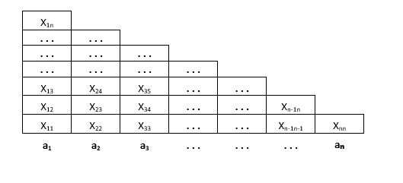
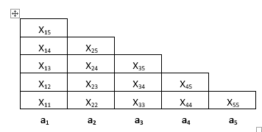
CYK (Cook, Younger and Kasami) algorithm

Slide 30
CYK (Cook, Younger and Kasami) algorithm
By definition of X_{ij} bottom row corresponds to a string of length one and top row corresponds to a string of length n , if |w| = n.
Theorem: The algorithm described above correctly computes X_{ij} for all i and j. Hence w∈ L(G), for a CFL L = L(G) if and only if S ∈ X_{1n}

Slide 31
Problems
Consider the CFG G with the following productions:
S₀ → AB / SA
S → AB / SA / a
A → AB / SA / a / b
B → SA
Test the membership of aba in L(G).
S a A a
A b

Slide 32
Problems
ab ba
S₀ SA aA ab S₀ AB bB
S SA aA ab S AB bB
A SA aA ab A AB bB
B SA aA ab
aba
S₀ SA SAA aAA abA aba
S SA SAA aAA abA aba
A SA SAA aAA abA aba
B SA SAA aAA abA aba

Slide 33
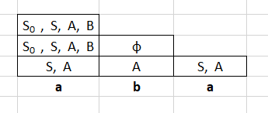
Problems
Since X₁₃ contains S₀ , aba ∈ L(G)

Slide 34
Given the following CFG in Chomsky normal form, check whether the membership of the following strings (using CYK algorithm)
i) ababa ii)aabb
S → AB / BC
A → BA / a
B→ CC / b
C → AB / a

Slide 35
Simplification of CFG
Elimination of Unit productions
Elimination of Null productions
Elimination of Useless symbols
G G₁ G₂ G₃ (Reduced Grammar)
Def: Let w∈L(G), then the sequence
S w₁ w₂ w₃ . . . . w_{n} w
is a derivation of the string (terminal) w. The strings S, w₁ , w₂ . . . , w_{n}
which contain non-terminals as well as terminals, are called sentential
forms of the derivation.

Slide 36
Elimination of Useless symbols
Def: Let G = (N, T, S, P) be a CFG. A symbol X is useful if there is a derivation S αXβ w for some α, β and w. Where w ∈ T*. Otherwise X is useless.
1) It should be possible to derive a terminal string from X.
αXβ w
2) It should be possible to derive a sentential form containing X from S.
S αXβ
or we can say X is reachable from S.

Slide 37
These two conditions are only the necessary conditions but not sufficient conditions. That is any non-terminal satisfies both the conditions does not imply it is useful.
Example:
S → aABbc
A → ac
S → cDd
D → cDd
D → cd
Here A is reachable from S and a terminal string can be derived from A
But this derivation does not produce a terminal string.
S aABbc aacBbc , A is useless symbol.

Slide 38
Lemma 1: Given a CFG G = (N, T, S, P), with L(G) ≠ φ, we can effectively find an equivalent CFG G’ = (N’, T, S, P’) such that for each A in N’ there is some w in T* for which A w.
begin
OLDN = {φ}
NEWN = { A / A → w for some w in T* }
While OLDN ≠ NEWN
begin
4. OLDN = NEWN
5. NEWN = OLDN U {A / A → α for some α in (T U OLDN)* }
end
6. N’ = NEWN
end

Slide 39
Example: G =({S, A, B, C, E}, { b, c, d }, S, P)
P: S → AB 1) OLDN = φ NEWN = { B, E}
S → AC
S → BC 2) OLDN = { B, E} NEWN = { B, E} U { C, E }
B → b = {B, C, E}
C → cEd 3) OLDN = { B, C, E} NEWN = {B, C, E} U { S, B, C, E }
E→ cEd = {S, B, C, E}
E → cd 4) OLDN = { S, B, C, E} NEWN = {S, B, C, E} U { S, B, C, E}
= {S, B, C, E}
G’ =({S, B, C, E}, { b, c, d }, S, P’)
P’: S → BC , B → b , C → cEd , E→ cEd , E → cd
L(G) = L(G’) , N’ ⊆ N , P’⊆ P

Slide 40
Lemma 2: Given a CFG G = (N, T, S, P), we can effectively find an equivalent CFG G’ = (N’, T’, S, P’) such that for each X in N’UT’ there exist an α and β ∈ (N’UT’) for which S αXβ.
Example: G =({S, A, B, C}, { a, b, c, d }, S, P)
S → AB N T N’ T’
A → aAb S a S a
A → ab A b A b
B → bB B c B
B → b C d
C→ cCd
C → cd
G’ =({S, A, B}, { a, b}, S, P’)
P’: S → AB , A → aAb , A → ab , B→ bB , B → b
L(G) = L(G’) , N’ ⊆ N , T’⊆ T , P’⊆ P

Slide 41
Example: G =({S, B, C, E}, { b, c, d }, S, P)
P: S → BC , B → b , C → cEd , E→ cEd , E → cd
N T N’ T’
S b S b
B c B c
C d C d
E E
Theorem: Every non-empty CFL generated by a CFG with no useless productions.
Lemma 1 Lemma 2
G = (N, T, S, P) G’ = (N’, T, S, P’) G’’ = (N’’, T’’, S, P’’)

Slide 42
To eliminate the useless symbols from a CFG,
1) apply Lemma 1
2) apply Lemma 2 (order is must)
Example:
Consider the grammar with productions
S → AB , S → a , A→ a L(G) = { a }
Apply Lemma 2 S → AB , S → a , A→ a
Apply Lemma 1 S → a , A→ a
Apply Lemma 1 S → a , A→ a
Apply Lemma 2 S → a

Slide 43
Elimination of Null Productions
Def: Any production of a CFG G = (N, T, S, P) of the form
A → ε
is called a ε-production or null production. A non-terminal A for which a derivation
A ε
is possible is called nullable or nullable non-terminal.
Theorem: If L=L(G) for some CFG G = (N, T, S, P), then L – {ε} is L(G’) for a CFG G’ with no useless symbols or ε-productions (or null production).

Slide 44
G = (N, T, S, P) G’ = (N, T, S, P’)
Step 1: Find all nullable non-terminals
Step 2: If A→ B₁B₂. . . B_{m} is a rule in P , then
A→ C₁C₂. . . C_{m} will be a rule in P’, where
C_{i} = B_{i} if B_{i} is not nullable
or
C_{i} = ε or B_{i} if B_{i} is nullable
but not all C_{i} can be ε

Slide 45
Example: 1
S → SaSbS (rule 1)
S → ε
Nullable = { S }
S → SaSbS
S → aSbS
S → SabS
S → SaSb
S → abS
S → Sab
S → aSb
S → ab

Slide 46
Example: 2
S → ABaC Nullable φ
A → BC Nullable B, C
B → b / ε Nullable A, B, C
C → D / ε
D → d
S → ABaC replaced as S → ABaC , S → BaC , S → AaC , S → ABa
S → aC , S → Aa , S → Ba , S → a
A → BC replaced as A → BC , A → B , A → C
B → b replaced as B → b
C → D replaced as C → D
D → d replaced as D → d

Slide 47
Elimination of Unit Productions
Def: Any production of a CFG G = (N, T, S, P) of the form
A → B
where A, B ∈N is called a unit production.
Theorem: Every CFL without ε can be generated by a CFG without unit productions.
Theorem: Every CFL without ε can be generated by a CFG without
ε -productions, unit productions and useless symbols.

Slide 48
G = (N, T, S, P) G’ = (N, T, S, P’)
Step 1: Find all pairs (A, B) such that A B
Step 2: P = P₁UP₂ where
P₁ is the set of all unit productions and
P₂ is the set of all non-unit productions
P’ = P₂ U For every pair (A, B) such that A B
add rules A→ β if B→ β∈ P₂

Slide 49
Example:
S → aSb
S → A L(G)= { a^{n}c^{m}d^{m}b^{n} / n ≥ 0, m ≥ 1 }
A → cAd
A → cd
Step 1: Find all pairs (A, B) such that A B
(S, A)
Step 2: P₁ = {S → A }
P₂ = {S → aSb , A → cAd , A → cd}
P’ = P₂ U {S → cAd , S → cd }
= {S → aSb , A → cAd , A → cd , S → cAd , S → cd }

Slide 50

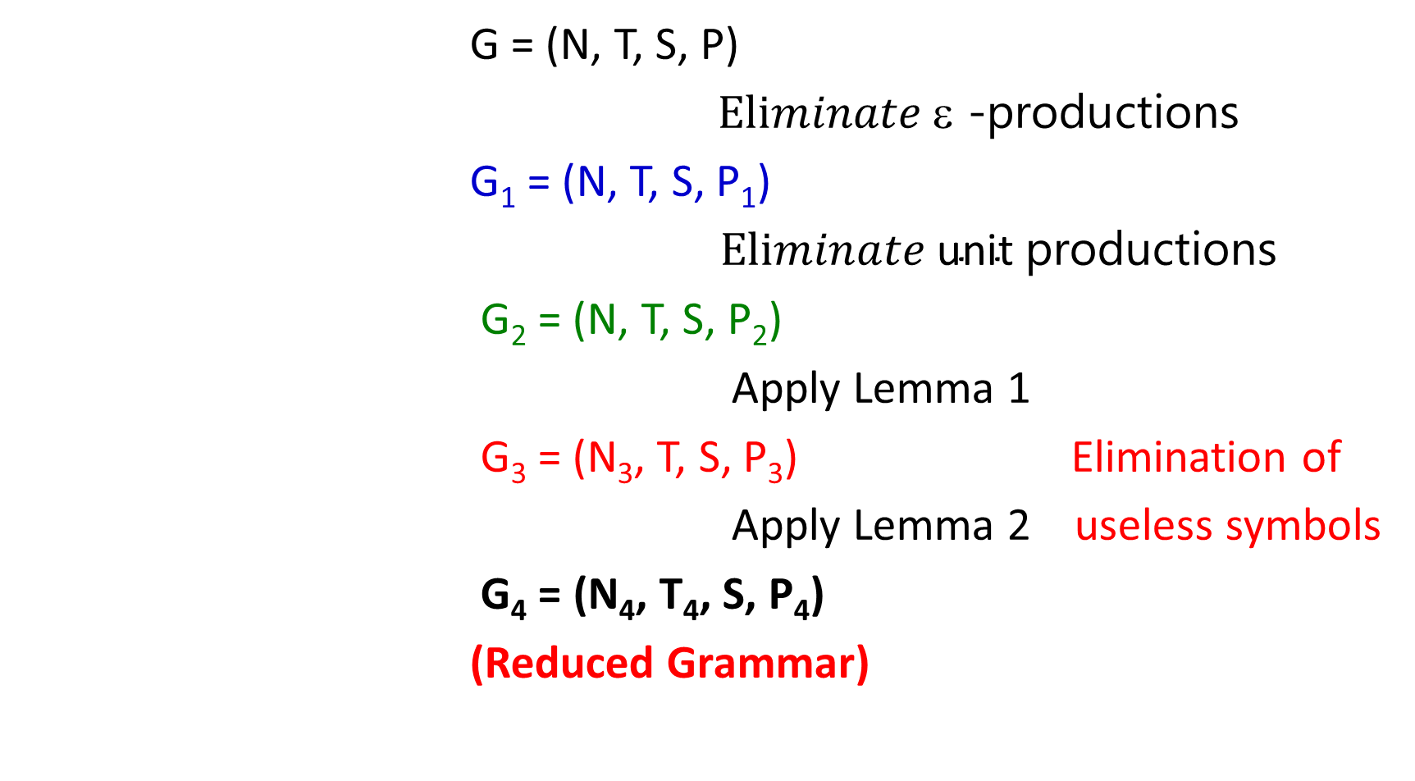



G = (N, T, S, P)
$Eliminate \text{ε }\text{−}\text{productions}$
G₁ = (N, T, S, P₁)
$Eliminate \text{unit} \text{p}\text{roductions}$
G₂ = (N, T, S, P₂)
Apply Lemma 1
G₃ = (N₃, T, S, P₃) Elimination of
Apply Lemma 2 useless symbols
G₄ = (N₄, T₄, S, P₄)
(Reduced Grammar)
$$⇓$$
$$⇓$$
$$⇓$$
$$⇓$$

Slide 51
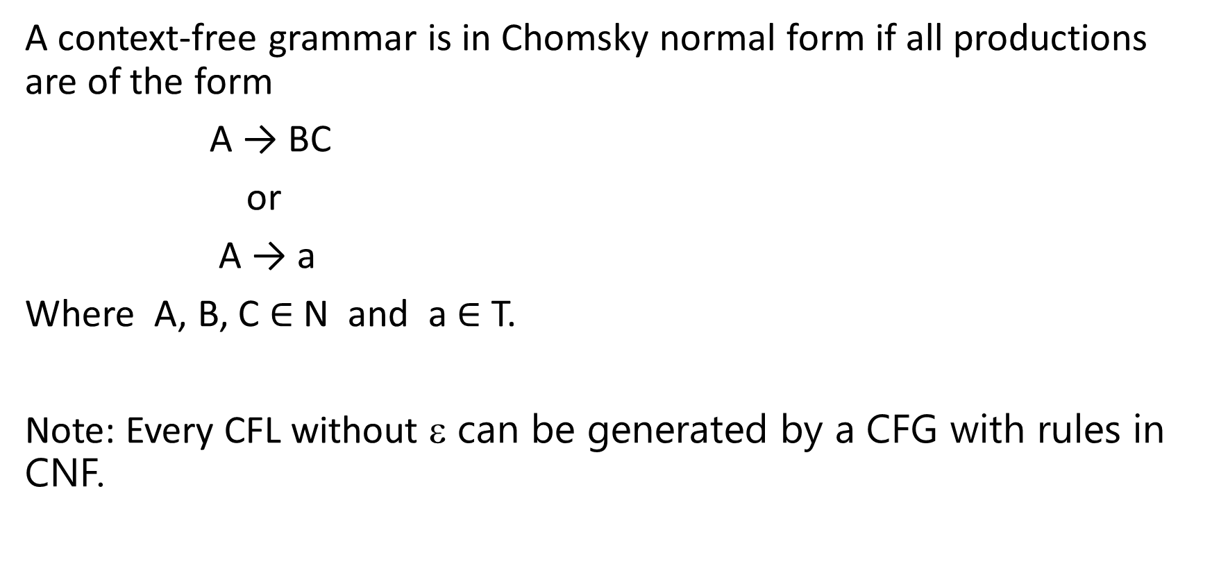
Chomsky Normal Form (CNF)
A context-free grammar is in Chomsky normal form if all productions are of the form
A → BC
or
A → a
Where A, B, C $∈$ N and a $∈$ T.
Note: Every CFL without ε can be generated by a CFG with rules in CNF.

Slide 52
Examples
The grammar with productions
S → AS / a
A → S A/ b
is in Chomsky normal form. But the grammar with productions
S → AS / AAS
A → S A/ aa
is not in Chomsky normal form.

Slide 53
Convert CFG into CNF
Consider the grammar G = ({S}, {a, b}, P, S), where
P: S → aSb
S → ab
Step :1 For every terminal symbol introduce a new non-terminal.
S → ASB A → a
S → AB B → b

Slide 54
Convert CFG into CNF
Step :2 If A→ B₁B₂. . . B_{m} is a rule, then it is replaced by
A→ B₁D₁
D₁→ B₂D₂
D₂→ B₃D₃
. . . . .
D_{m-3}→ B_{m-2}D_{m-2}
D_{m-2}→ B_{m-1}B_{m}
S → AD A → a
D → SB
S → AB B → b

Slide 55
Problems
2) Convert the grammar in CNF
E → E+E
E → E*E
E → (E)
E → a
Step :1 For every terminal symbol introduce a new non-terminal.
E → EPE P → +
E → EME M → *
E → LER L → ( R → )
E → a

Slide 56
Problems (Continued..)
Step :2
E → ED₁ P → +
D₁ → PE
E → E D₂ M → *
D₂ → ME
E → L D₃ L → ( R → )
D₃ → ER
E → a

Slide 57
Problems
3) Convert the grammar in CNF
S → aAD
A → aB
A → bAB
B → a
D → d
4) Convert the grammar in CNF
S → aSa
S → bSb
S → c

Slide 58
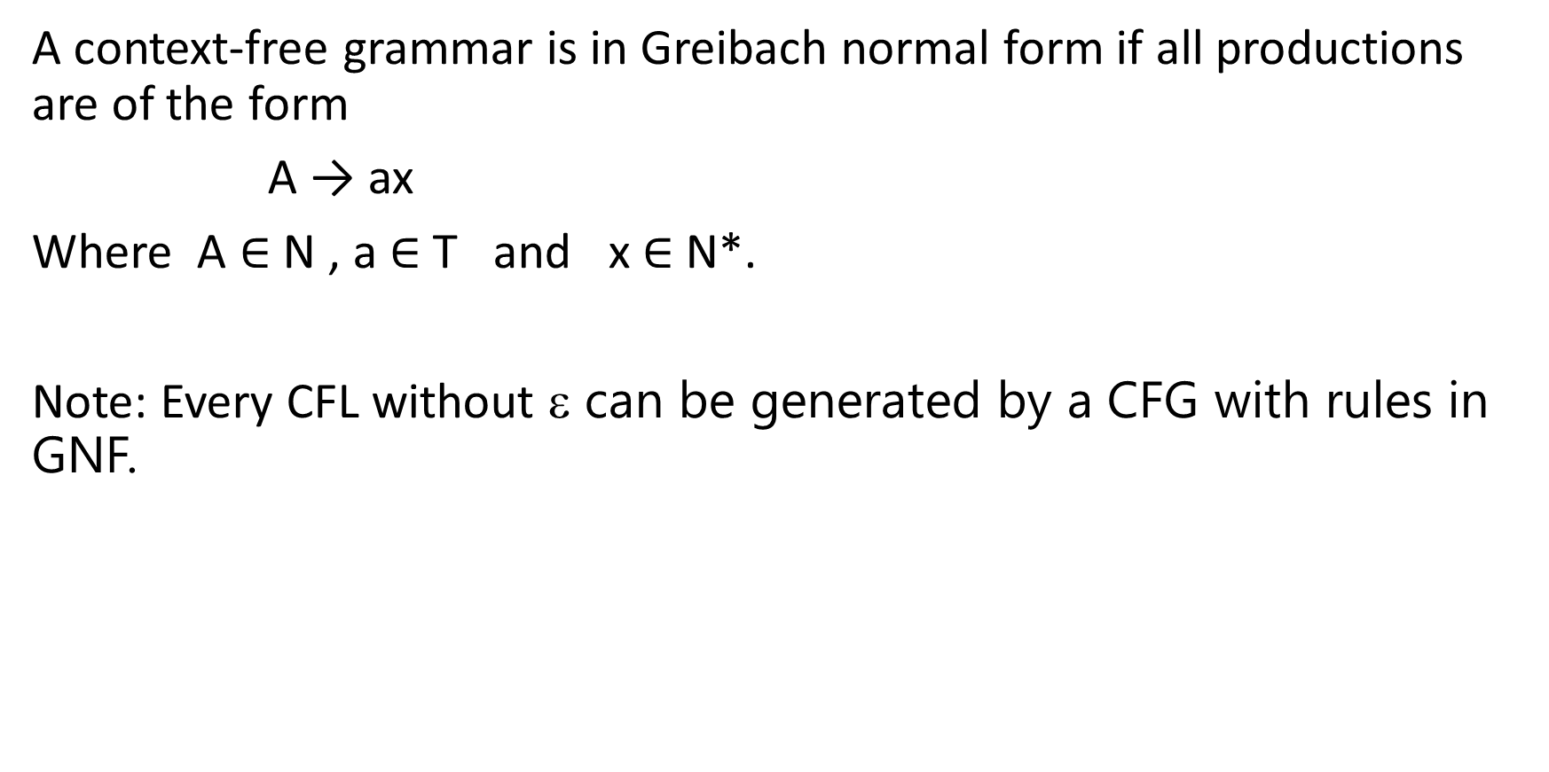
Greibach Normal Form (GNF)
A context-free grammar is in Greibach normal form if all productions are of the form
A → ax
Where A $∈$ N , a $∈$ T and x $∈$ N*.
Note: Every CFL without ε can be generated by a CFG with rules in GNF.

Slide 59
Lemma 1:
Define an A-production to be a production with non-terminal A on the left. Let G = (N, T, P, S) be a context-free grammar. Let A → α₁Bα₂ be a production in P and B → β₁ / β₂ /. . . / β_{r} be the set of all B-productions.
Let G₁ = (N, T, P₁, S) be obtained from G by deleting the production
A → α₁Bα₂
from P and adding the productions
A → α₁ β₁ α₂ / α₁ β₂ α₂ / . . . / α₁ β_{r} α₂
Then L(G) = L(G₁).

Slide 60
Lemma 2:
Let G = (N, T, P, S) be a context-free grammar. Let A → Aα₁ / Aα₂ /. . . / Aα_{r}
be the set of all A-productions for which A is the leftmost symbol of the
RHS. Let A → β₁ / β₂ /. . . / β_{s} be the remaining A-productions.
Let G₁ = (NU{Z}, T, P₁, S) be the CFG formed by adding the non-terminal Z
to N and replacing all the A-productions
A → β_{i} 2) Z → α_{i}
A → β_{i} Z , 1≤ i ≤ s Z → α_{i} Z , 1≤ i ≤ r
Then L(G) = L(G₁).

Slide 61
Convert CFG into GNF
Consider the grammar G = ({S}, {a, b}, P, S), where
P: S → aSb
S → ab
Step :1 For every terminal symbol introduce a new non-terminal.
S → ASB A → a
S → AB B → b
Step :2 Introduce order among non-terminals by renaming them.
S = A₁ A₁ → A₂ A₁ A₃ A₂ → a
A = A₂ A₁ → A₂ A₃ A₃ → b
B = A₃

Slide 62
Step :3 Use Lemma 1 and Lemma 2 and convert the rules in a such way that at the end of this step, the rules are in GNF or of the form
A_{i} → A_{j} γ , j > i
You may also have some Z rules.
Step :4 Convert the A_{i} rules into GNF by back substitution
A_{n} substitute in A_{n-1}
A_{n-1} substitute in A_{n-2} . . . .
A₁ → a A₁ A₃ A₂ → a
A₁ → a A₃ A₃ → b
Step :5 Convert the Z rules into GNF

Slide 63
Example:2
S → SS
S → aSb
S → ab
Step :1 For every terminal symbol introduce a new non-terminal.
S → SS
S → ASB A → a
S → AB B → b
Step :2 Introduce order among non-terminals by renaming them.
S = A₁ A₁ → A₁ A₁
A = A₂ A₁ → A₂ A₁ A₃ A₂ → a
B = A₃ A₁ → A₂ A₃ A₃ → b

Slide 64
Step :3
A₁ → A₁ A₁
A₁ → A₂ A₁ A₃ / A₂ A₃
A₂ → a
A₃ → b
Apply Lemma 2 for A₁ productions, we get
A₁ → A₂ A₁ A₃ / A₂ A₃
A₁ → A₂ A₁ A₃ Z / A₂ A₃Z
Z → A₁ / A₁ Z
A₂ → a
A₃ → b

Slide 65
Step :4 Convert the A_{i} rules into GNF by back substitution
A₁ → aA₁ A₃ / aA₃
A₁ → aA₁ A₃ Z / aA₃Z
Z → A₁ / A₁ Z
A₂ → a
A₃ → b
Step :5 Convert the Z rules into GNF
A₁ → aA₁ A₃ / aA₃ / aA₁ A₃ Z / aA₃Z
Z → aA₁ A₃ / aA₃ / aA₁ A₃ Z / aA₃Z / aA₁ A₃ Z / aA₃ Z / aA₁ A₃ Z Z / aA₃Z Z
A₂ → a
A₃ → b

Slide 66
Example:3
S → AS / a
A → SA / b
Step :1 For every terminal symbol introduce a new non-terminal.
S → AS / a
A → SA / b
Step :2 Introduce order among non-terminals by renaming them.
S = A₁ A₁ → A₂A₁ A₁ → a
A = A₂ A₂ → A₁A₂ A₂ → b

Slide 67
Step :3
A₁ → A₂A₁ / a
A₂ → A₁A₂
A₂ → b
Apply Lemma 1 for A₂ → A₁A₂ productions, we get
A₂ → A₂A₁A₂ / aA₂
A₁ → A₂A₁ / a
A₂ → b
Apply Lemma 2 for A₂ → A₂A₁A₂ productions, we get
A₂ → aA₂ / b / aA₂ Z / bZ
Z → A₁A₂ / A₁A₂Z
A₁ → A₂A₁ / a

Slide 68
Step :4 Convert the A_{i} rules into GNF by back substitution
A₁ → aA₂ A₁ / b A₁ / aA₂ Z A₁ / bZ A₁ / a
A₂ → aA₂ / b / aA₂ Z / bZ
Z → A₁A₂ / A₁A₂Z
Step :5 Convert the Z rules into GNF
A₁ → aA₂ A₁ / b A₁ / aA₂ Z A₁ / bZ A₁ / a
A₂ → aA₂ / b / aA₂ Z / bZ
Z → aA₂ A₁ A₂ / b A₁ A₂/ aA₂ Z A₁A₂ / bZ A₁ A₂/ aA₂
Z → aA₂ A₁ A₂ Z / b A₁ A₂ Z / aA₂ Z A₁A₂ Z / bZ A₁ A₂ Z / aA₂ Z

Slide 69
Convert the following grammars into GNF:
1) S → aSa
S → bSb
S → a
S → b
2) S → ABa /a
A → aaA / B
B → bAb
3) S → ab
S → aS
S → aaS

Slide 70
Pumping lemma for context-free languages
Let L be an infinite context-free language. Then there exists some positive integer n such that for any w∈L with |w|≥ n can be decomposed as
w = uvxyz
with |vxy| ≤ n and |vy| ≥ 1
such that
w_{i} = uv^{i}xy^{i}z is also in L for i = 0, 1, 2, . . .

Slide 71
Example:1 Prove that L = { a^{n}b^{n} c^{n} / n ≥ 1 } is not context-free.
Assume that L is context-free language.
Let n be a positive integer.
Let w = a^{n}b^{n} c^{n}. Then |w| = 3n ≥ n
Therefore, by pumping lemma w can be decomposed as
w = uvxyz with |vxy| ≤ n and |vy| ≥ 1 both v and y not null
As 1 ≤ |vy| ≤ n, v or y cannot contain all the three symbols a, b, c
So, v or y is of the form
case 1: v or y contains only a’s (or b’s or c’s )
case 2: v or y is of the form a^{i}b^{j} (or b^{i}c^{j} )

Slide 72
Case 1: v or y contains only a’s (or b’s or c’s )
v or y contains only a’s v = a^{i} , 1 ≤ i ≤ n
w = uvxyz = a^{n}b^{n} c^{n} = a^{n-i}a^{i}b^{n} c^{n}
w₀ = uxz = a^{n-i}b^{n} c^{n} , 1 ≤ i ≤ n
w₀ L , contradiction.
Case 2: v or y is of the form a^{i}b^{j} (or b^{i}c^{j} )
v or y is of the form a^{i}b^{j} v = a^{i}b^{j} , 1 ≤ i+j ≤ n
w = uvxyz = a^{n}b^{n} c^{n}
w₂ = uv²xy²z = ua^{i}b^{j} a^{i}b^{j} xy²z
w₂ L , contradiction.
Hence L is not CFL.

Slide 73
Example:2 Prove that L = { a^{p} / p is prime } is not context-free.
Assume that L is context-free language.
Let n be a positive integer and let p be a prime num greater than n i.e. p > n.
Let w = a^{p}. Then |w| = p > n
Therefore, by pumping lemma w can be decomposed as
w = uvxyz with |vxy| ≤ n and |vy| ≥ 1 both v and y not null.
|vy| ≥ 1 , |vxy| ≤ n 1 ≤ |vy| ≤ n
|vy| = m , 1 ≤ m ≤ n
Let i = p +1 p = i -1
Consider
| uv^{i}xy^{i}z| = |uvxyz| + |(vy)^{i - 1}| = |uvxyz| + |vy|(i -1)
= p + m(i -1) = p + mp = (m+1)p , is not prime.
Therefore, uv^{i}xy^{i}z L , a contradiction.
Thus L is not context-free language.

Slide 74
Prove the following languages are not context-free:
L ={ ww / w ∈ { a, b}* }
L ={ ww^{R}w / w ∈ { a, b}* }
L ={ a^{n}b^{m} c^{n} d^{m} / n, m ≥ 1 }
L = { a^{n}b^{n} c^{m} / n ≠ m }

Slide 75
Closure Properties of CFL
A context-free language is closed under the following operations:
i) Union
ii) Concatenation
iii) Kleene closure
2. A context-free language is not closed under
i) Intersection
ii) Complementation
3. A context-free language is closed under reversal.
4. If L is a context-free language and R is a regular language, then
L∩R is context-free language.

Slide 76
If L₁ and L₂ are context-free languages, then L₁UL₂ is a context-free
language.
Proof: L₁ is a CFL there exist a CFG G₁ = (N₁, T₁, S₁, P₁) such that G₁
generates L₁
L₂ is a CFL there exist a CFG G₂ = (N₂, T₂, S₂, P₂) such that G₂
generates L₂
Now, Construct a CFG G by combining G₁ and G₂ that will generate L₁UL₂
G = (N₁U N₂U{S} , T₁UT₂ , S , P₁UP₂U{S→S₁ , S→S₂} )
Then L(G) = L₁UL₂

Slide 77
2. If L₁ and L₂ are context-free languages, then L₁L₂ is a context-free
language.
Proof: L₁ is a CFL there exist a CFG G₁ = (N₁, T₁, S₁, P₁) such that G₁
generates L₁
L₂ is a CFL there exist a CFG G₂ = (N₂, T₂, S₂, P₂) such that G₂
generates L₂
Now, Construct a CFG G by combining G₁ and G₂ that will generate L₁L₂
G = (N₁U N₂U{S} , T₁UT₂ , S , P₁UP₂U{S→S₁S₂} )
Then L(G) = L₁L₂

Slide 78
3. If L₁ is a context-free language, then L₁* is a context-free
language.
Proof: L₁ is a CFL there exist a CFG G₁ = (N₁, T₁, S₁, P₁) such that G₁
generates L₁
Now, Construct a CFG G by from G₁ that will generate L₁*
G = (N₁U{S} , T₁ , S , P₁U{S→S₁S /ε} )
Then L(G) = L₁*

Slide 79
4. Context-free languages are not closed under intersection.
Proof: Let us consider two context-free languages L₁ and L₂ , where
L₁ = { a^{n}b^{n} c^{m} / n, m ≥ 1 }
L₂ = { a^{n}b^{m} c^{m} / n, m ≥ 1 }
The productions of L₁ are
P: S₁ → AB , A → aAb / ab , B → cB / c
The productions of L₂ are
P: S₂ → CD , C → aC / a , D → bDc / bc
So, L₁ and L₂ are context-free languages. But
L₁∩L₂ = { a^{n}b^{n} c^{n} / n ≥ 1 } which is context-sensitive language.
Therefore, context-free languages are not closed under intersection.

Slide 80
5. Context-free languages are not closed under complementation.
Proof: Assume that CFL is closed under complementation.
Then, L₁ is a CFL L₁^{c} is also context-free language.
L₂ is a CFL L₂^{c} is also context-free language.
L₁^{c} and L₂^{c} are CFLs L₁^{c} U L₂^{c} is context-free language
L₁^{c} U L₂^{c} is context-free language (L₁^{c} U L₂^{c})^{c} is also context-free
But, (L₁^{c} U L₂^{c})^{c} = L₁∩L₂ is not context-free, a contradiction.
Hence, CFL is not closed under complementation

Slide 81
6. If L is a context-free language, then so is L^{R}
Proof: L is a CFL there exist a CFG G = (N, T, S, P) such that
G generates L
A grammar generating L^{R} is given by G^{R} = (N, T, S, P^{R}) ,
P^{R} can be obtained from P by reversing the right hand side of the production
P^{R} = { A → α^{R} / A → α ∈ P}

Slide 82
7. If L is a context-free language and R is a regular language, then
L∩R is context-free language.
Proof: L is a CFL there exists a PDA M₁ =(Q₁, Σ₁, Γ₁, δ₁, q₁, Z₁, F₁)
such that M₁ accepts L
R is regular there exists a DFA M₂ =(Q₂, Σ₂, δ₂, q₂, F₂)
such that M₂ accepts R
We can combine M₁ and M₂ into a single PDA
M=(Q, Σ, Γ, δ, [q₁, q₂ ], Z, F) , where
Q = Q₁ x Q₂ , Σ = Σ₁ U Σ₂ , Γ = Γ₁ , Z = Z₁ , F = F₁ x F₂
([p_{i}, p_{j} ] , β ) ∈ δ([q_{m}, q_{n} ] , a , b) if and only if
(p_{i} , β ) ∈ δ₁(q_{m} , a , b) and δ₂ (q_{n} , a ) = p_{j}

Slide 83
Problem 1: Show that the language L = { a^{n}b^{n} / n ≥ 0, n ≠ 100} is context-free.
Solution: L = {ε, ab, a²b², . . . , a⁹⁹b⁹⁹ , a¹⁰¹b¹⁰¹ , . . . }
S → aS₁b / ε
S₁ → aS₂b / ε
S₂ → aS₃b / ε
. . . . . . . . .
. . . . . . . . .
S₉₈ → aS₉₉b / ε
S₉₉ → aS₁₀₀b / ε
S₁₀₀ → aS₁₀₁b
S₁₀₁ → aS₁₀₁b / ε Hence L is CFL.

Slide 84
L = { a^{n}b^{n} / n ≥ 0, n ≠ 100}
Let L₁ = { a¹⁰⁰b¹⁰⁰ } , it is finite and hence it is regular.
L₁ is regular its complement is also regular. That is
L₁^{c} = Σ*- L₁ is regular.
L₁^{c} = {a, b}*- { a¹⁰⁰b¹⁰⁰ } is regular.
L₂ = { a^{n}b^{n} / n ≥ 0 } is context-free language.
Therefore,
L₂ ∩ L₁^{c} = { a^{n}b^{n} / n ≥ 0, n ≠ 100} is context-free language.

Slide 85
PUSHDOWN AUTOMATA (PDA)
Regular Language Type-3 FSA DFA
NFA
ε-NFA
Regular Exp.
Not Regular Language Pumping Lemma
Myhill - Nerode Theorem
CFL Type-2 PDA (NPDA)
NPDA ≠ DPDA
DPDA NPDA
(LR Grammar) DCFL CFL

Slide 86
Context-Sensitive Grammars and Languages
1) G= ({S}, {a, b, c }, P, S), where
P: S → aSBc (rule 1) S abc
S → abc (rule 2) S aSBc aabcBc aabBcc aabbcc
cB → Bc (rule 3)
bB →bb (rule 4) S aSBc aaSBcBc aaabcBcBc
aaabBccBc aaabBcBcc aaabBBccc
aaabbBccc aaabbbccc
L(G) = { a^{n}b^{n}C^{n}/ n ≥ 1 }

Slide 87
Grammars and Languages
6) G= ({S, A, B}, {a, b}, P, S), where
P: S → AB (rule 1) S AB aAbB aaB aaε = aa
A → aAb (rule 2) S AB aAbB aAbbbB aAbbbε
bB → bbbB (rule 3) aabb
aAb →aa (rule 4) S AB aAbB aAbbbB aAbbbε
B → ε (rule 5) aaAbbbb
aaabbb
L(G) = { a^{n+1}b^{n+k}/ n ≥ 1, k = -1, 1, 3, 5, . . .}

